Slide 1




Slide 2

Kuwait

Slide 3
Introduction

Slide 4
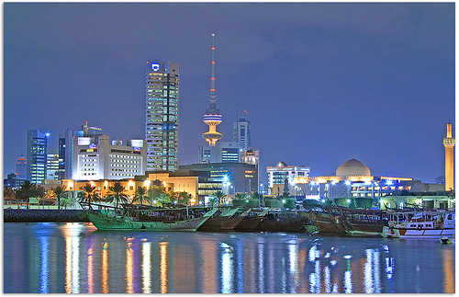

Kuwait City

Slide 5
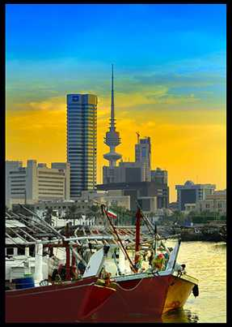
Kuwait City Harbour

Slide 6
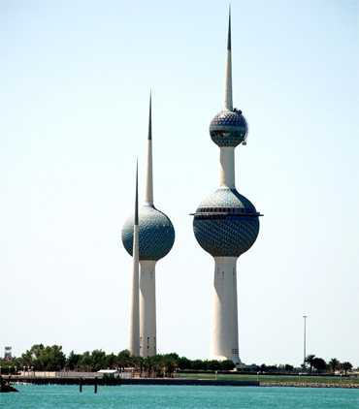
Kuwait Towers

Slide 7
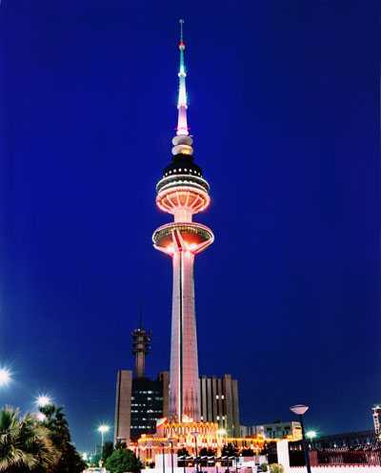
Liberation Tower

Slide 8
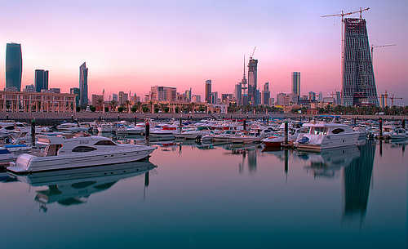
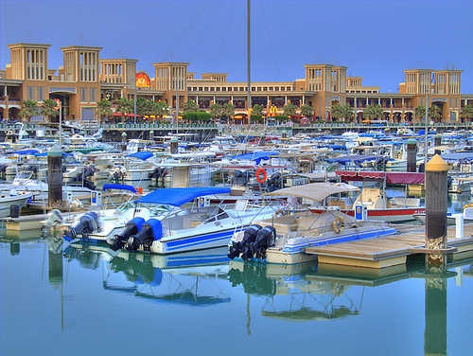
Sharq Harbour

Slide 9
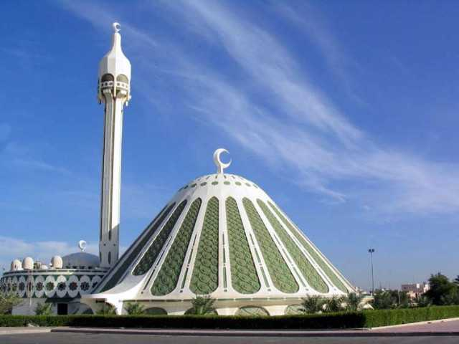
Mosque

Slide 10
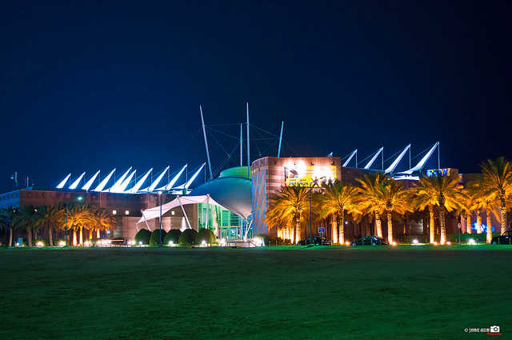
Scientific Centre

Slide 11
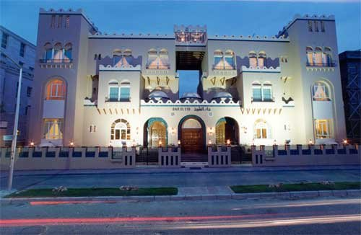
Tareq Rajab Museum

Slide 12
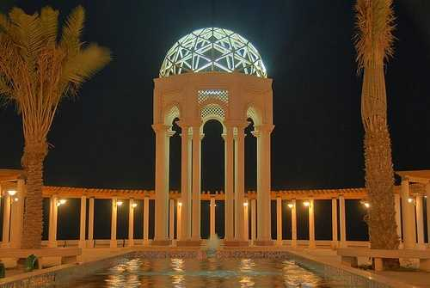
Light Dome

Slide 13
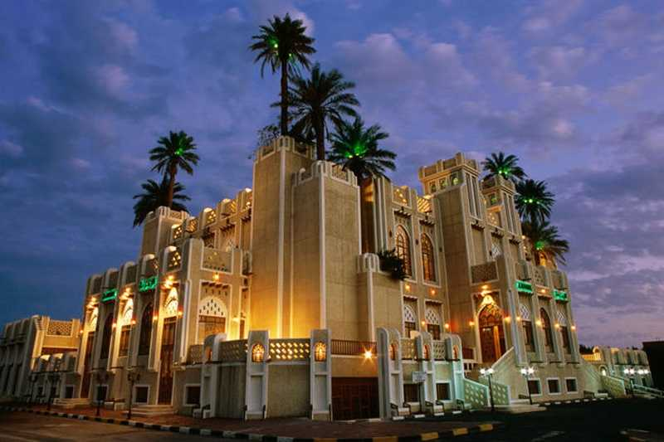
Al Zumerida Hall

Slide 14
Places to Visit

Slide 15
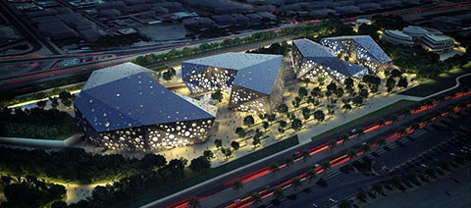
Sheikh Jaber Al-Ahmed Cultural Center

Slide 16
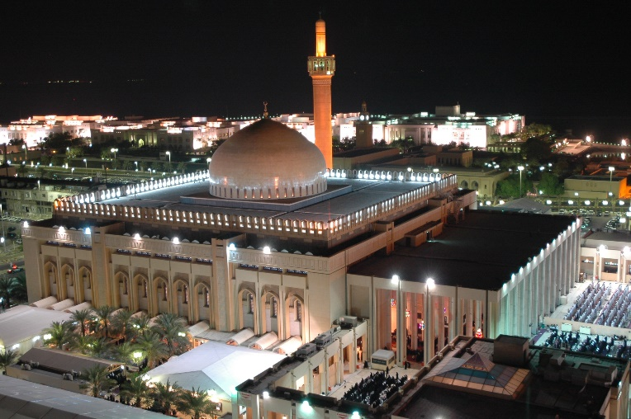
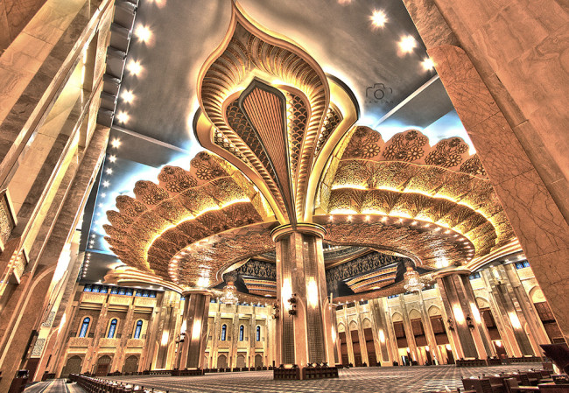
Grand Mosque

Slide 17
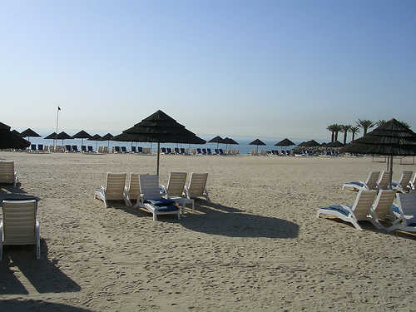
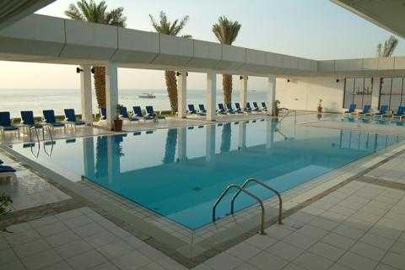
Hilton Beach & Pool

Slide 18
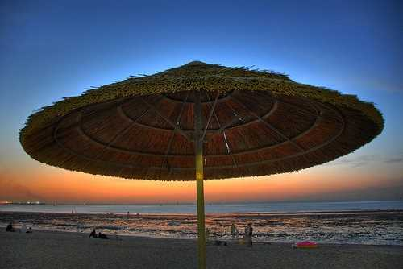
Shuwaikh Beach

Slide 19
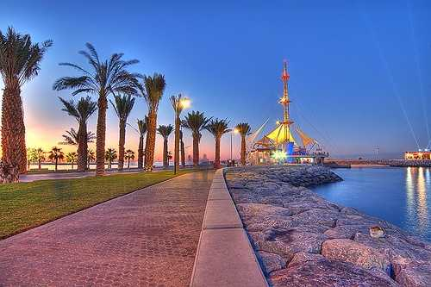
Marina Walkway

Slide 20
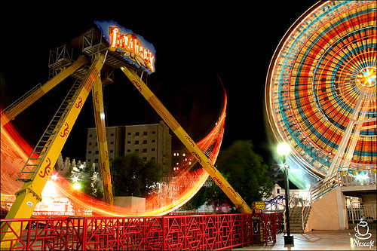
Entertainment Park

Slide 21
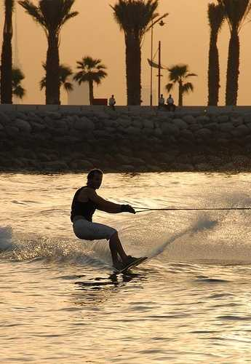
Water Play

Slide 22
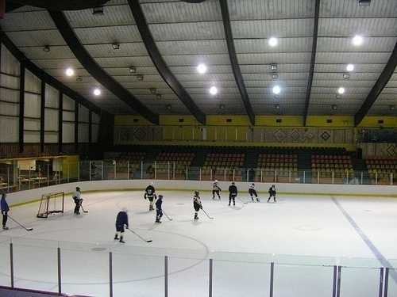
Ice Skating and Hockey

Slide 23

AL HamraTower

Slide 24
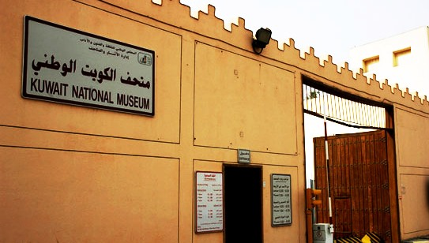
Kuwait National Museum

Slide 25
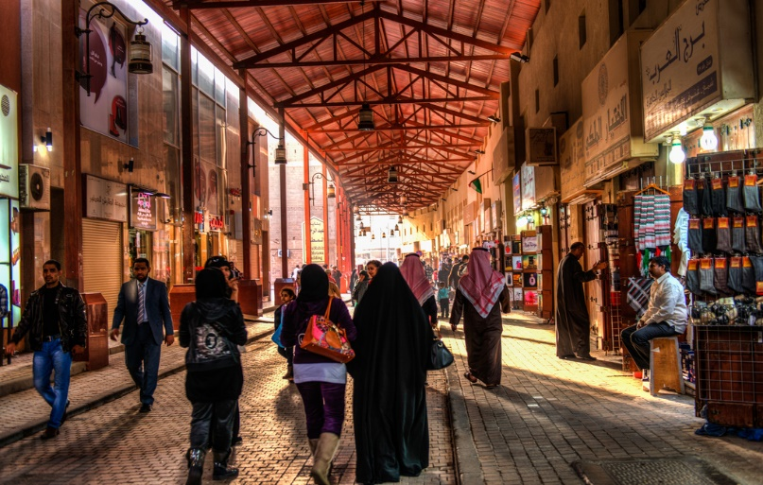
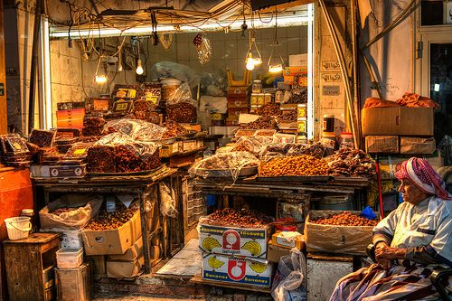
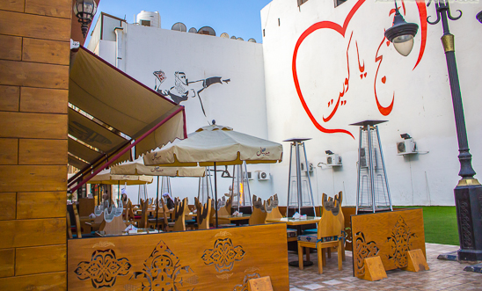
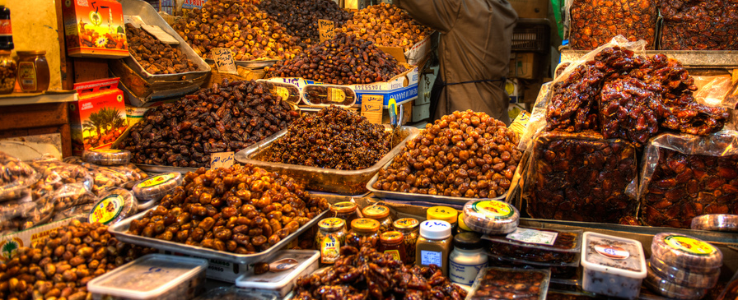
Souk Al-Mubarakiya

Slide 26
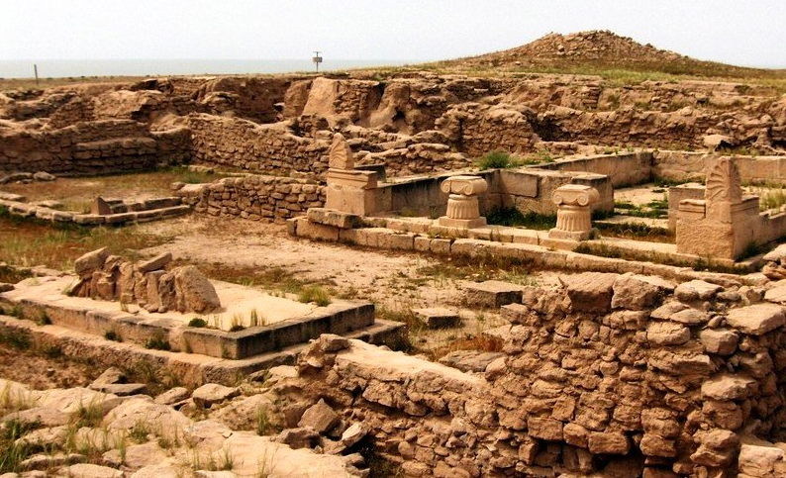
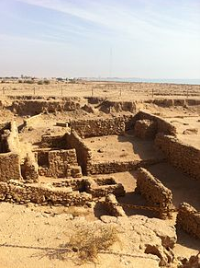
Failaka Island

Slide 27
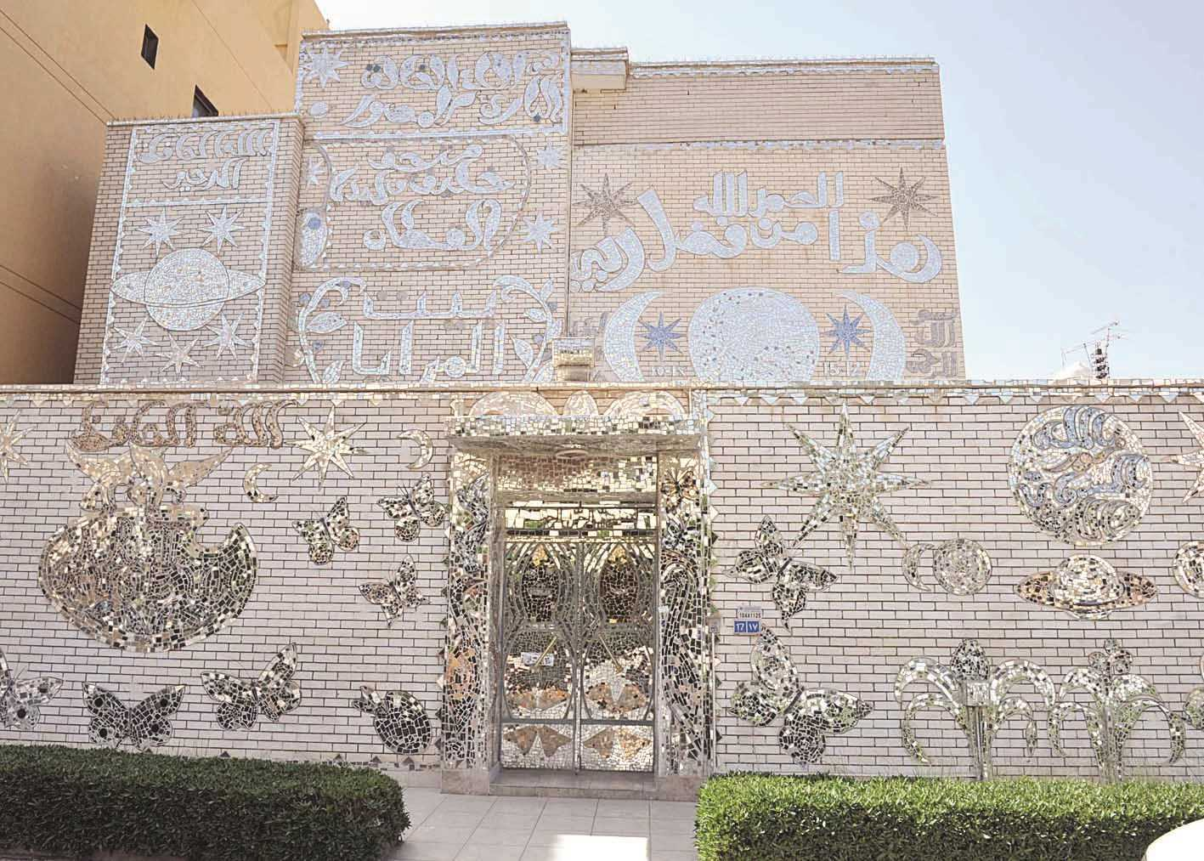
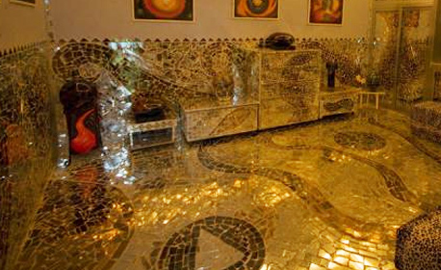
House of Mirrors

Slide 28
Shopping

Slide 29
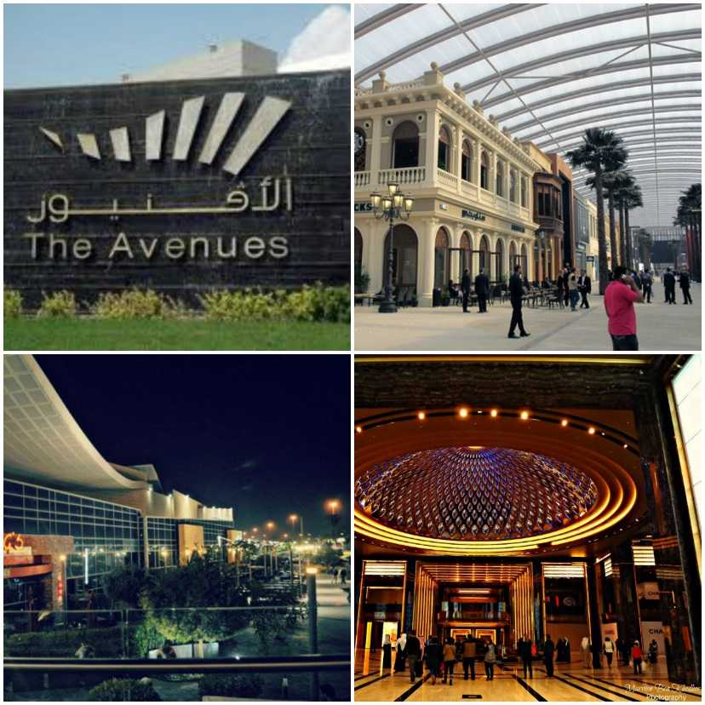
The Avenues

Slide 30
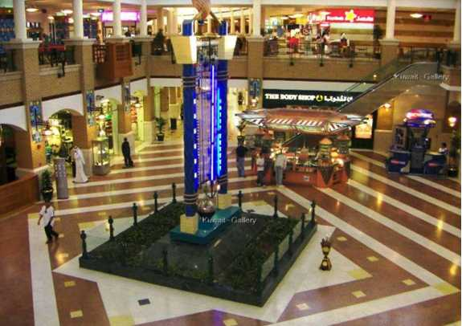
Souq Sharq Mall

Slide 31
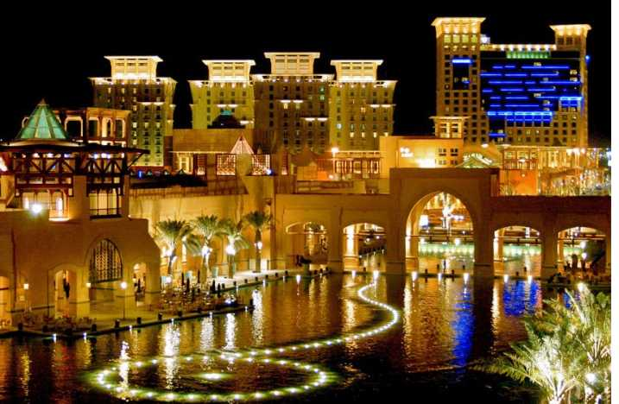
Al Kout Mall

Slide 32
Restaurants

Slide 33
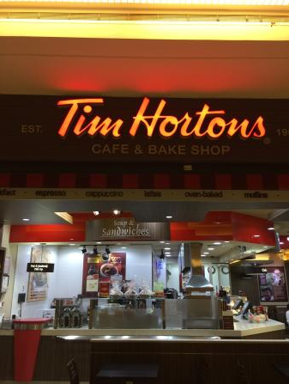
Tim Hortons

Slide 34
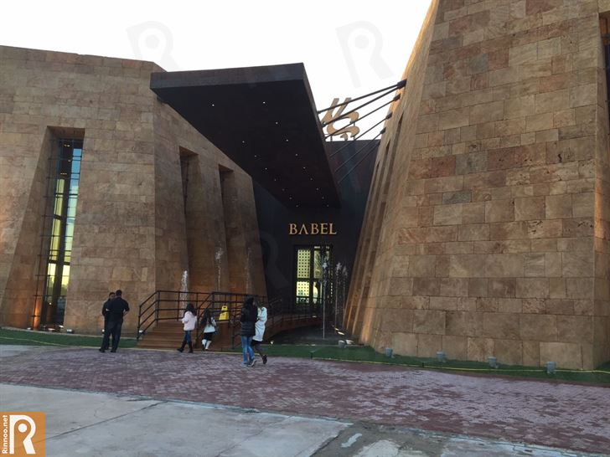
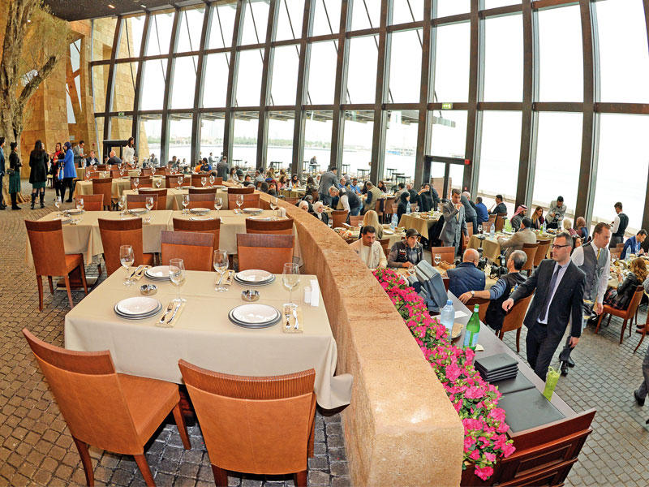
Babel

Slide 35
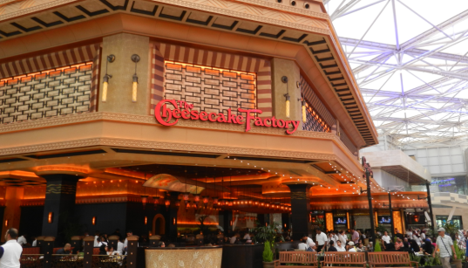

Cheesecake Factory

Slide 36
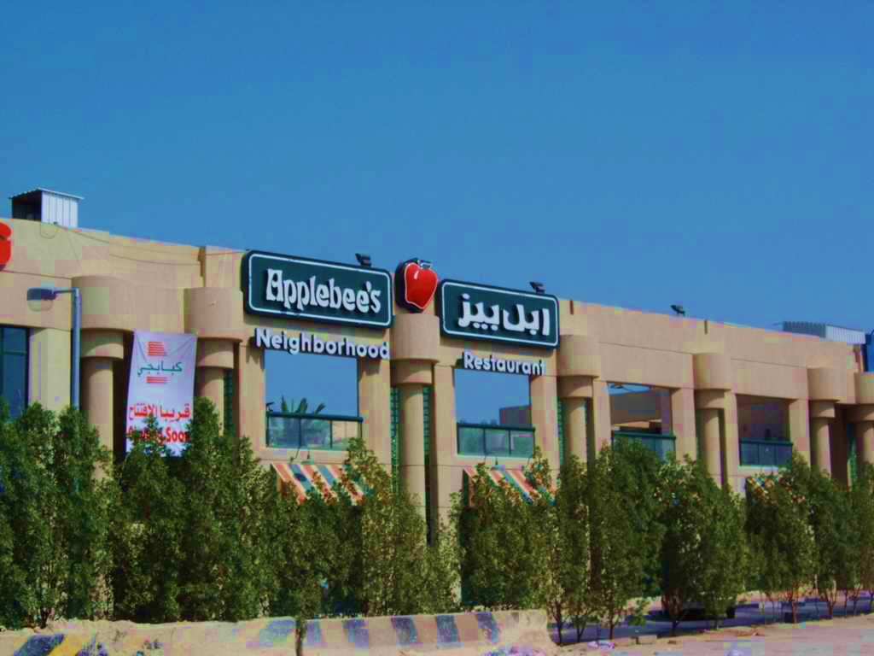
Applebee's

Slide 37

Ruby Tuesday

Slide 38

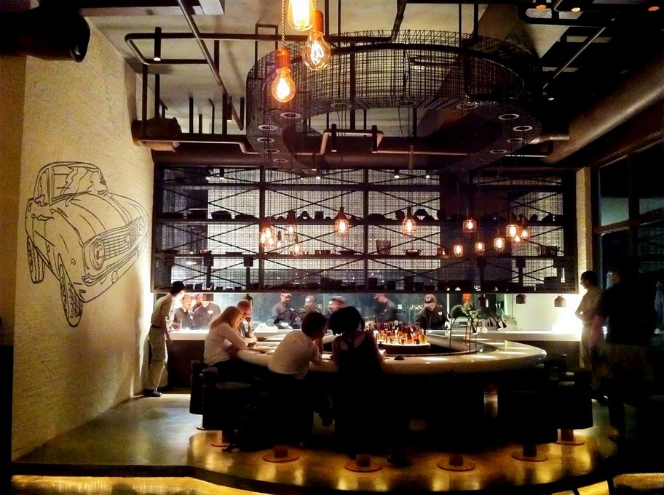
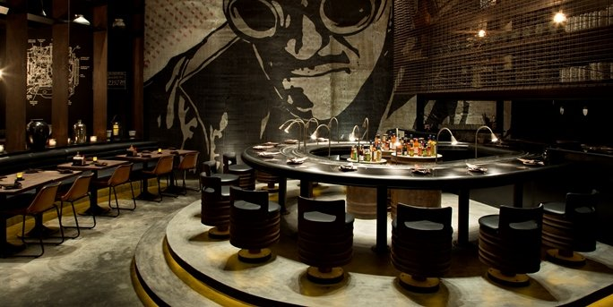

Slide 39
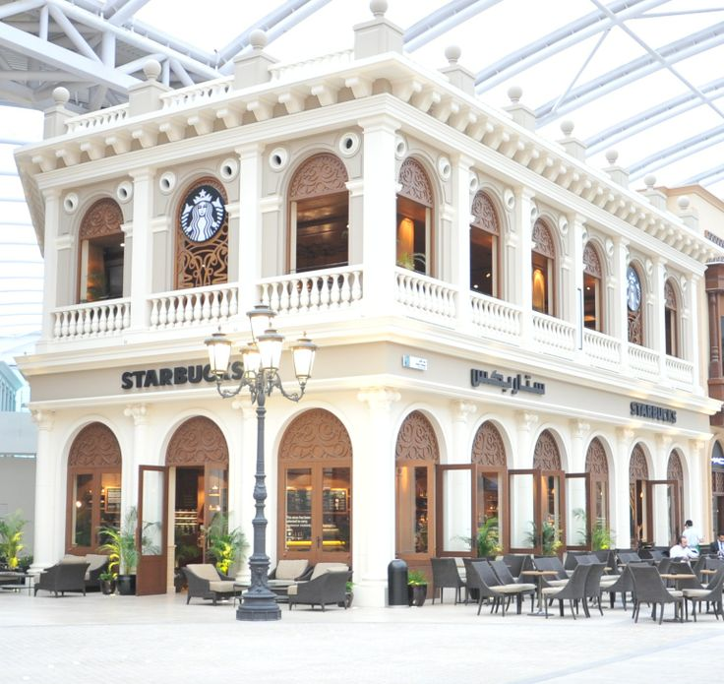
Starbucks

Slide 40
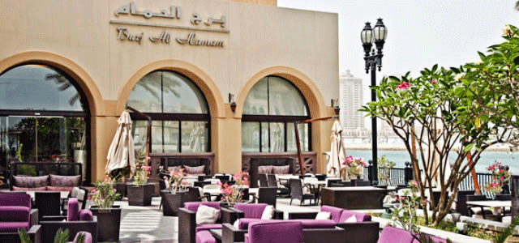
Burj Al-Hamam

Slide 41
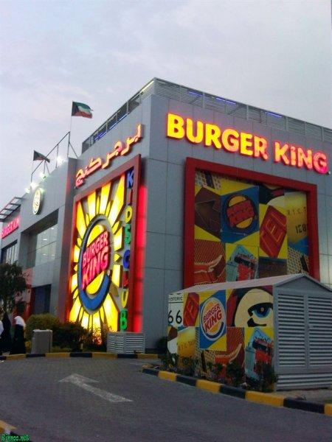
Burger King

Slide 42

Hardee’s

Slide 43
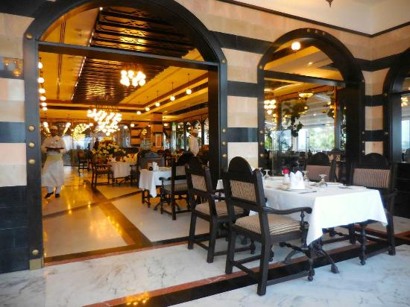
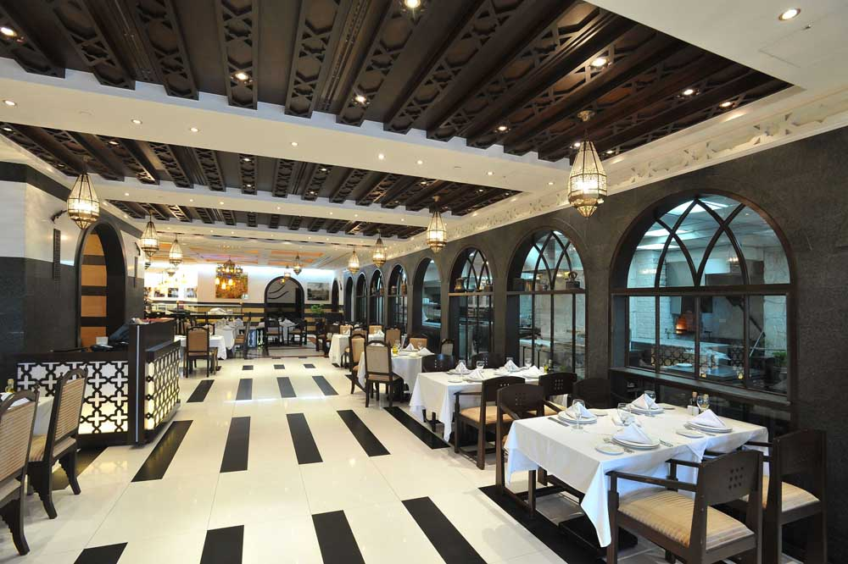
Naranj Restaurant

Slide 44
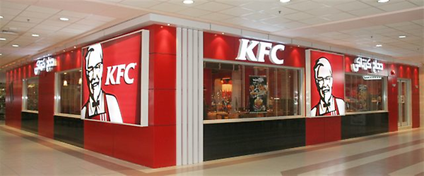
KFC

Slide 45
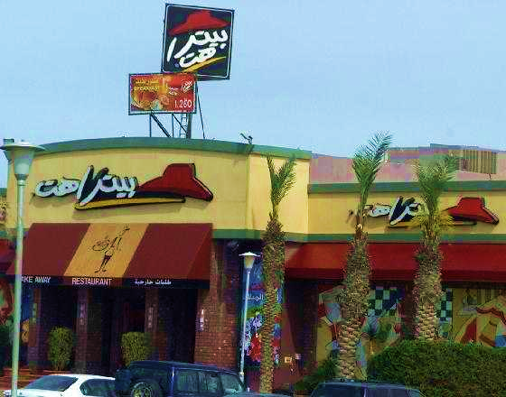
Pizza Hut

Slide 46
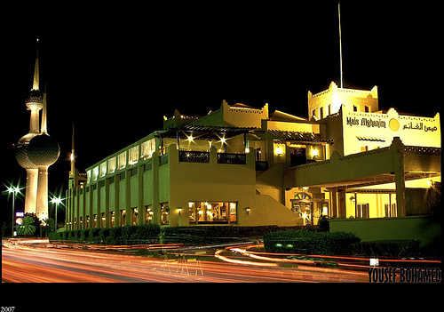
Mais Al Ghanim Restaurant

Slide 47
Kuwaiti Tradition

Slide 48
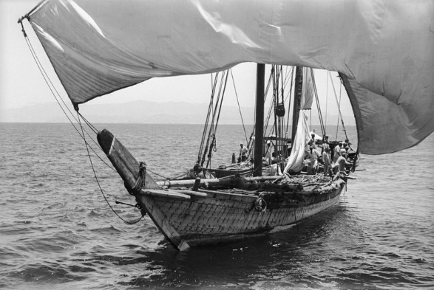
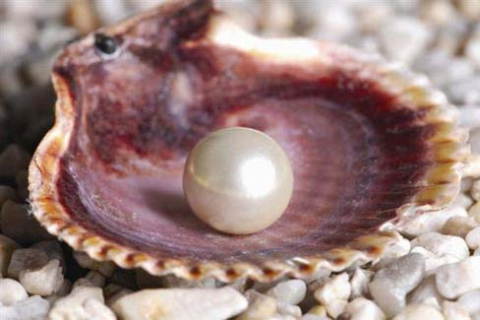



Pearl Diving

Slide 49

Diwaniya

Slide 50

Sadu House

Slide 51




Fishing

Slide 52

Vegetable Market

Slide 53

Kuwaiti Dinar

Slide 55

Front Entrance

Slide 56


Front Foyer

Slide 57


Auditorium / Gym

Slide 58


Classrooms

Slide 59


Classroom Setup

Slide 60


Play Areas

Slide 61

Soccer Field

Slide 62


Library

Slide 63


Computer Lab

Slide 64





Apartment Photos

Slide 65




International School Leadership Conference

Slide 66


Kuwait National Day Celebration

Slide 67

Healthy Living Week

Slide 68





Sports Day

Slide 69




Fun day

Slide 70

Book Fair

Slide 71

SK Graduation

Slide 72
Social events for staff

Slide 73



Bowling

Slide 74




Visit to Chalet

Slide 75



Yacht Trip

Slide 76



Desert Camping

Slide 77
Canadian Bilingual School
Canadian Bilingual School is located in a developing area of South Khaitan in wealthy and safe Kuwait. Our school first opened its doors to students in September 2007. Our school includes JK through Grade 12, as of September 2020.Canadian Bilingual School has been created to not only promote the strengths and support the weaknesses of children individually but also to challenge each student to flourish intellectually by developing their own special talent.
The school offers a dual language curriculum, English and Arabic which enables the students to be competent in both languages. Our English curriculum is aligned with the AERO Common Core Standards which is supported by all the appropriate texts and resources. The Arabic and Islamic curriculum is provided by the Kuwait MOE.
We have many exciting and challenging programs throughout the academic year that will enhance each child's learning skills and talents thus allowing individual giftedness to flourish, whether it be in the area of art, music, drama, sports or within one of the academic subjects.

Slide 78
Mission Statement
Mission Statement:
At CBS we promote a respectful, safe and supportive environment encouraging high expectations and academic success.
Core Beliefs:
We believe in:
Individual accountability.
Having a positive belief in people.
Developing critical thinking.

Slide 79
Canadian Bilingual School facilities :
Spacious, bright classrooms each with computer access and a class library.
An auditorium/gym for school and sports activities
Large play areas.
School library.
Computer labs.
Carefully nurtured garden settings for both the interior and the exterior of the school.
Soccer fields.

Slide 80
Curriculum
The curriculum at CBS is a framework of consistent and challenging programs that are interesting and intellectually stimulating. Through a variety of collaborative and independent approaches and activities, our students are prepared for a lifetime of learning.
Our curriculum has been developed using the current standard teaching practices and is aligned with the AERO Common Core standards, NGSS standards, National standards, and Kuwait National standards. It is driven by collaboration, rigour, relevance and readiness. While these standards provide the base of our studies, additional enriching concepts and resources address the social and emotional competencies of our students.

Slide 81
Curriculum
Teachers use Curriculum expectations and achievement level charts to ensure the expectations of the appropriate grade level are met. These charts are used in lesson and unit planning for the teacher, and are reflected in the report cards and used as references when discussing progress with the parents.
At Canadian Bilingual School, English is the language of instruction in the four core subjects: Language Arts, Mathematics, Science and Social Studies, as well as with the Specialist topics: Computers, Art, Library and Physical Education.
Arabic and Islamic Studies are significant parts of the curriculum as mandated by the Kuwait Ministry of Education.
As Canadian Bilingual School teaches both English and Arabic skills, the two languages are taught with integration as a goal. The common themes as well as shared days of celebration, are a focus of our program.

Slide 82
Subjects
Building strong foundational skills is vital for student success and the central focus of our program is to extend and refine the core skills and strategies learned in kindergarten, through each grade.
The English instruction in language, math, science, social studies, art and physical education is designed to create knowledgeable and effective second language speakers, readers and writers.
As a bilingual school, Arabic and Islamic Studies are significant parts of the curriculum as mandated by the Kuwait Ministry of Education.
CBS also offers opportunities for students to learn outside of the traditional classroom through specialty subjects such as physical education, computer and library programs that are designed to strengthen and broaden both mind and body.

Slide 83
Teaching Program
CBS adheres to an American core curriculum and enhances knowledge in subject areas of Maths, Science, Social Studies and Art where students have opportunities to utilize their English language skills such as reading, writing, analysing, problem-solving, etc.
When developing the Mathematics and Science programs, teachers weave together related expectations as well as relevant mathematical and scientific processes such as a hands-on-approach using manipulatives.
Teachers bring enthusiasm and varied teaching approaches to the classroom, addressing different student needs and ensuring sound learning opportunities for each student.

Slide 84
Assessments & Resources
As part of evaluating learning, regular assessments enable teachers and students to monitor progress and modify instruction accordingly. It is important for teachers to use a variety of instructional assessment and evaluation strategies, in order to provide numerous opportunities for students to develop their ability to solve problems, reason mathematically, and connect the mathematics they are learning to the real world around them. In addition to a variety of classroom assessments, students also complete standardized MAP testing to assess their skills and knowledge in English, Math and Science.
Canadian Bilingual School uses a wide range of diverse texts and resources to support the curriculum – all North American or British published books and teaching materials. This is important as we are fulfilling a wide range of requirements, skills and talents across our school population. The children's needs will be well met.

Slide 85
Extracurricular
As our Mission Statement says, we are "Bringing Talent to Life" for each of our students. The academic area does not always provide a venue for such success in the case of all students.
We therefore encourage all opportunities to nurture talent and develop the arts:
- plays - visual arts - music
Debates and student conferences
- sports involvement through activities such as: soccer, basketball, volleyball, track & field
All these events are acknowledged through regular classroom recognition and monthly awards assemblies. We use newsletters to keep parents updated of upcoming assignments and tests. When a child accomplishes a feat, wins an award, reads a good book, presents at a musical recital or is acknowledged at a sports event, the parents are encouraged to inform the school about it.

Slide 86
Accreditation
Canadian Bilingual School has been accredited by Middle States Association of Colleges and Schools Commissions on Elementary and Secondary Schools from KG to Grade 12

Slide 87
Contact Us
E-mail : careers@cbskuwait.com
Address: Block 2, Zaid Al Khalil Street, Ibn Hesham Kindergarten Building, South Khaitan, Kuwait
Phone : (965) – 24744023 Fax : (965) – 24743470
Website : www.cbskuwait.com

